Slide 1
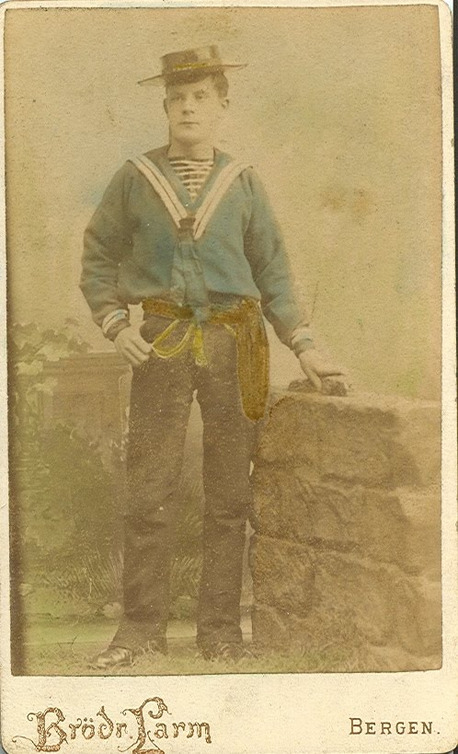
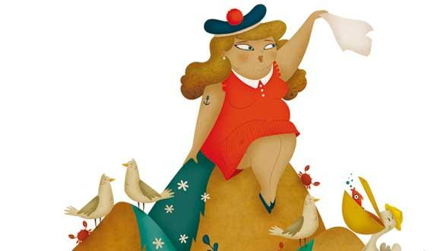
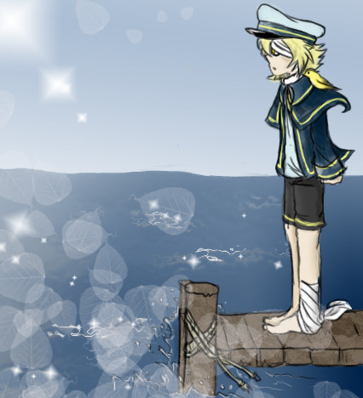
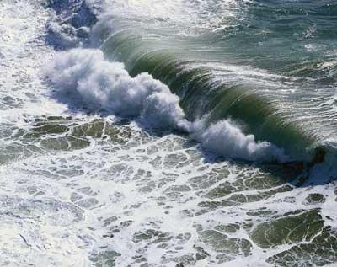
My Bonnie is over the Ocean
1 af 4
My Bonnie is over the ocean My Bonnie is over the sea. My Bonnie is over the ocean. Oh bring back my Bonnie to me.
Bring back, bring back, oh bring back my Bonnie to me, to me, Bring back, bring back, oh bring back my Bonnie to me.

Slide 2
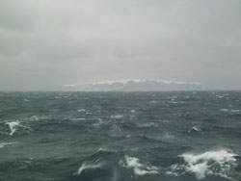
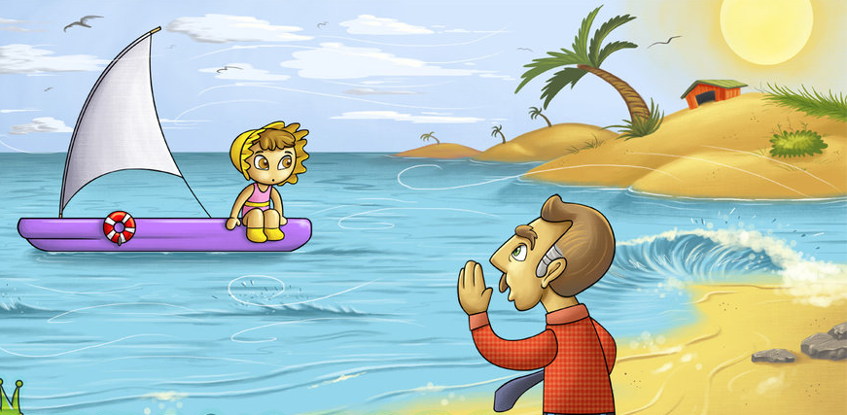
2 af 4
Oh, blow, ye winds, over the ocean Oh, blow ye winds over the sea. Oh, blow, ye winds, over the ocean And bring back my Bonnie to me.
Bring back, bring back, oh bring back my Bonnie to me, to me, Bring back, bring back, oh bring back my Bonnie to me.

Slide 3
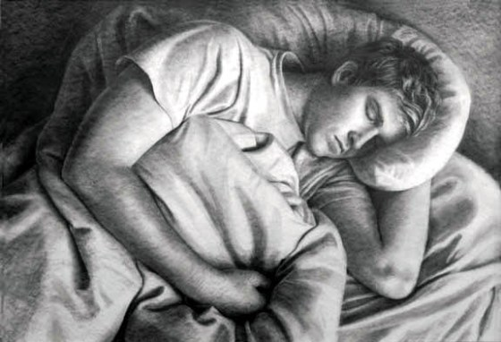
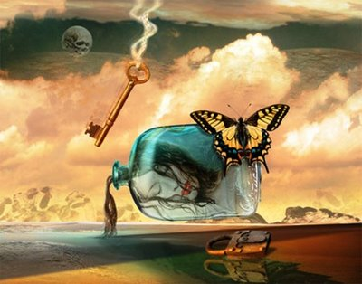
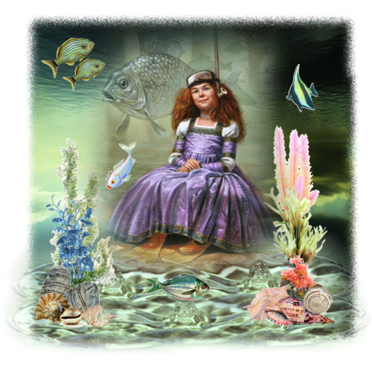
3 af 4
Last night as I lay on my pillow, Last night as I lay on my bed: Last night as I lay on my pillow, I dreamt that my Bonnie was dead.
Bring back, bring back, oh bring back my Bonnie to me, to me, Bring back, bring back, oh bring back my Bonnie to me.

Slide 4
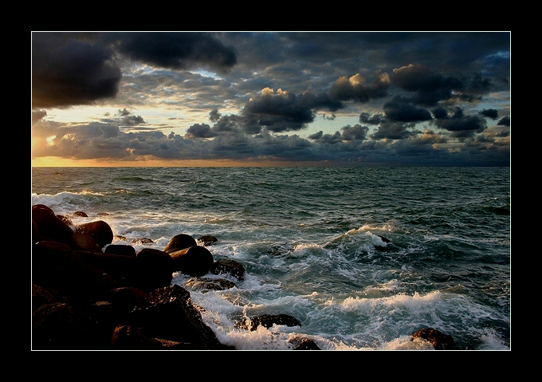
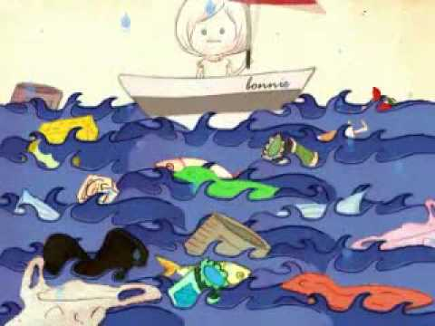
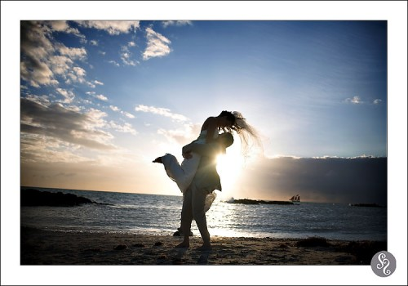
4 af 4
The winds have blown over the ocean, The winds have blown over the sea The winds have blown over the ocean, And bro't back my Bonnie to me.
Bring back, bring back, oh bring back my Bonnie to me, to me, Bring back, bring back, oh bring back my Bonnie to me.

